Slide 1
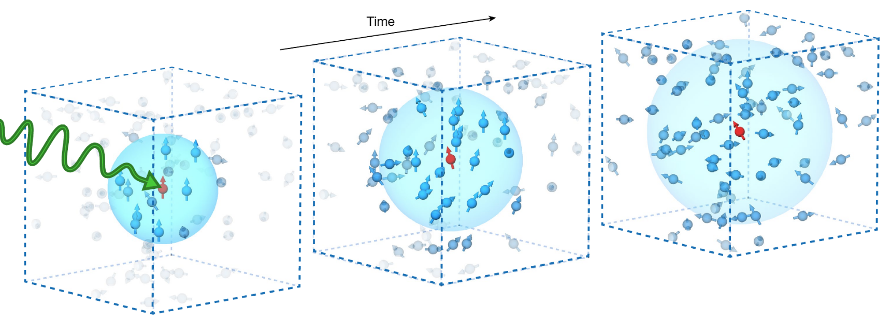
Brief Overview of NV-Center
Che Liu
Yao Group
3/5/2023
Image: C. Zu, F. Machado, B. Ye, S. Choi, B. Kobrin, T. Mittiga, S. Hsieh, P. Bhattacharyya, M. Markham, D. Twitchen, A. Jarmola, D. Budker, C.R. Laumann, J.E. Moore, N. Y. Yao, Nature 597, 45–50 (2021)

Slide 2
Applications of Quantum Mechanics
Sensing
Computation (for computing and for memory, error correction)
Analog simulation (Hamiltonian engineering)
Network (Entanglement generation)

Slide 3
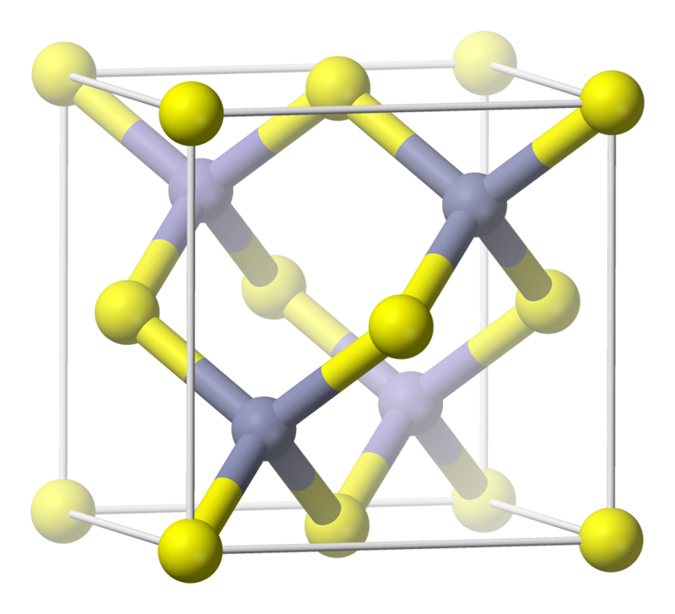
Diamond Lattice and Unit Cell
Diamond unit cell made from tetrahedral structures
Whole lattice formed by repeating the same unit cell → Bloch wave (delocalized)
Looks like a semiconductor, i.e. band gap between conduction and insulation band
Diamond Lattice Unit Cell

Slide 4
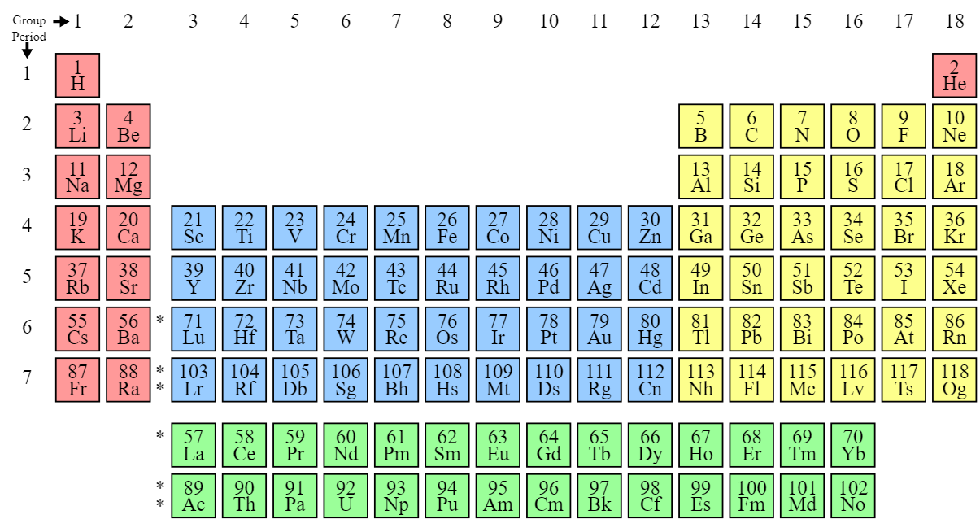
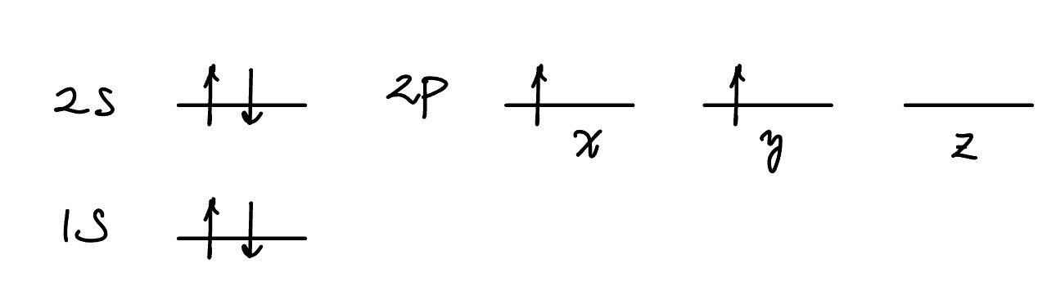
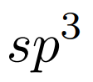
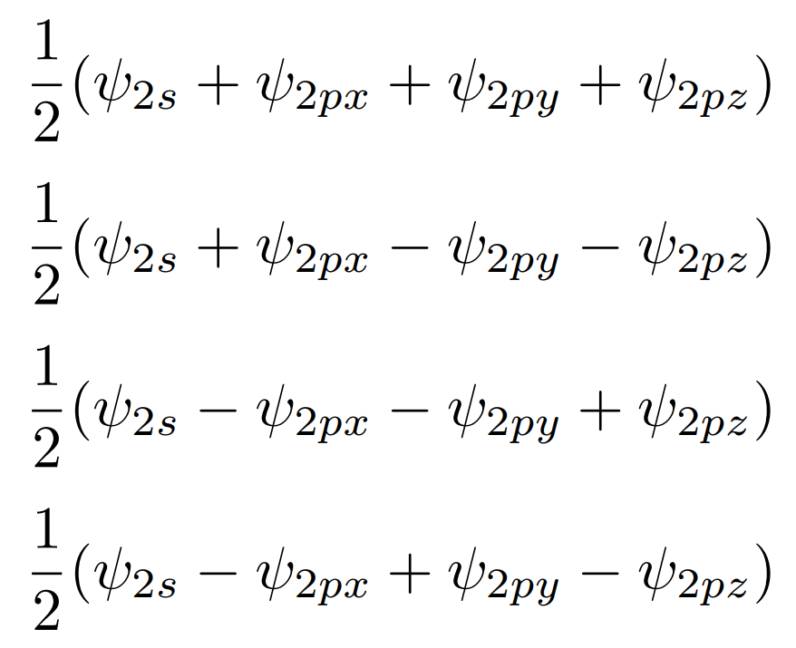
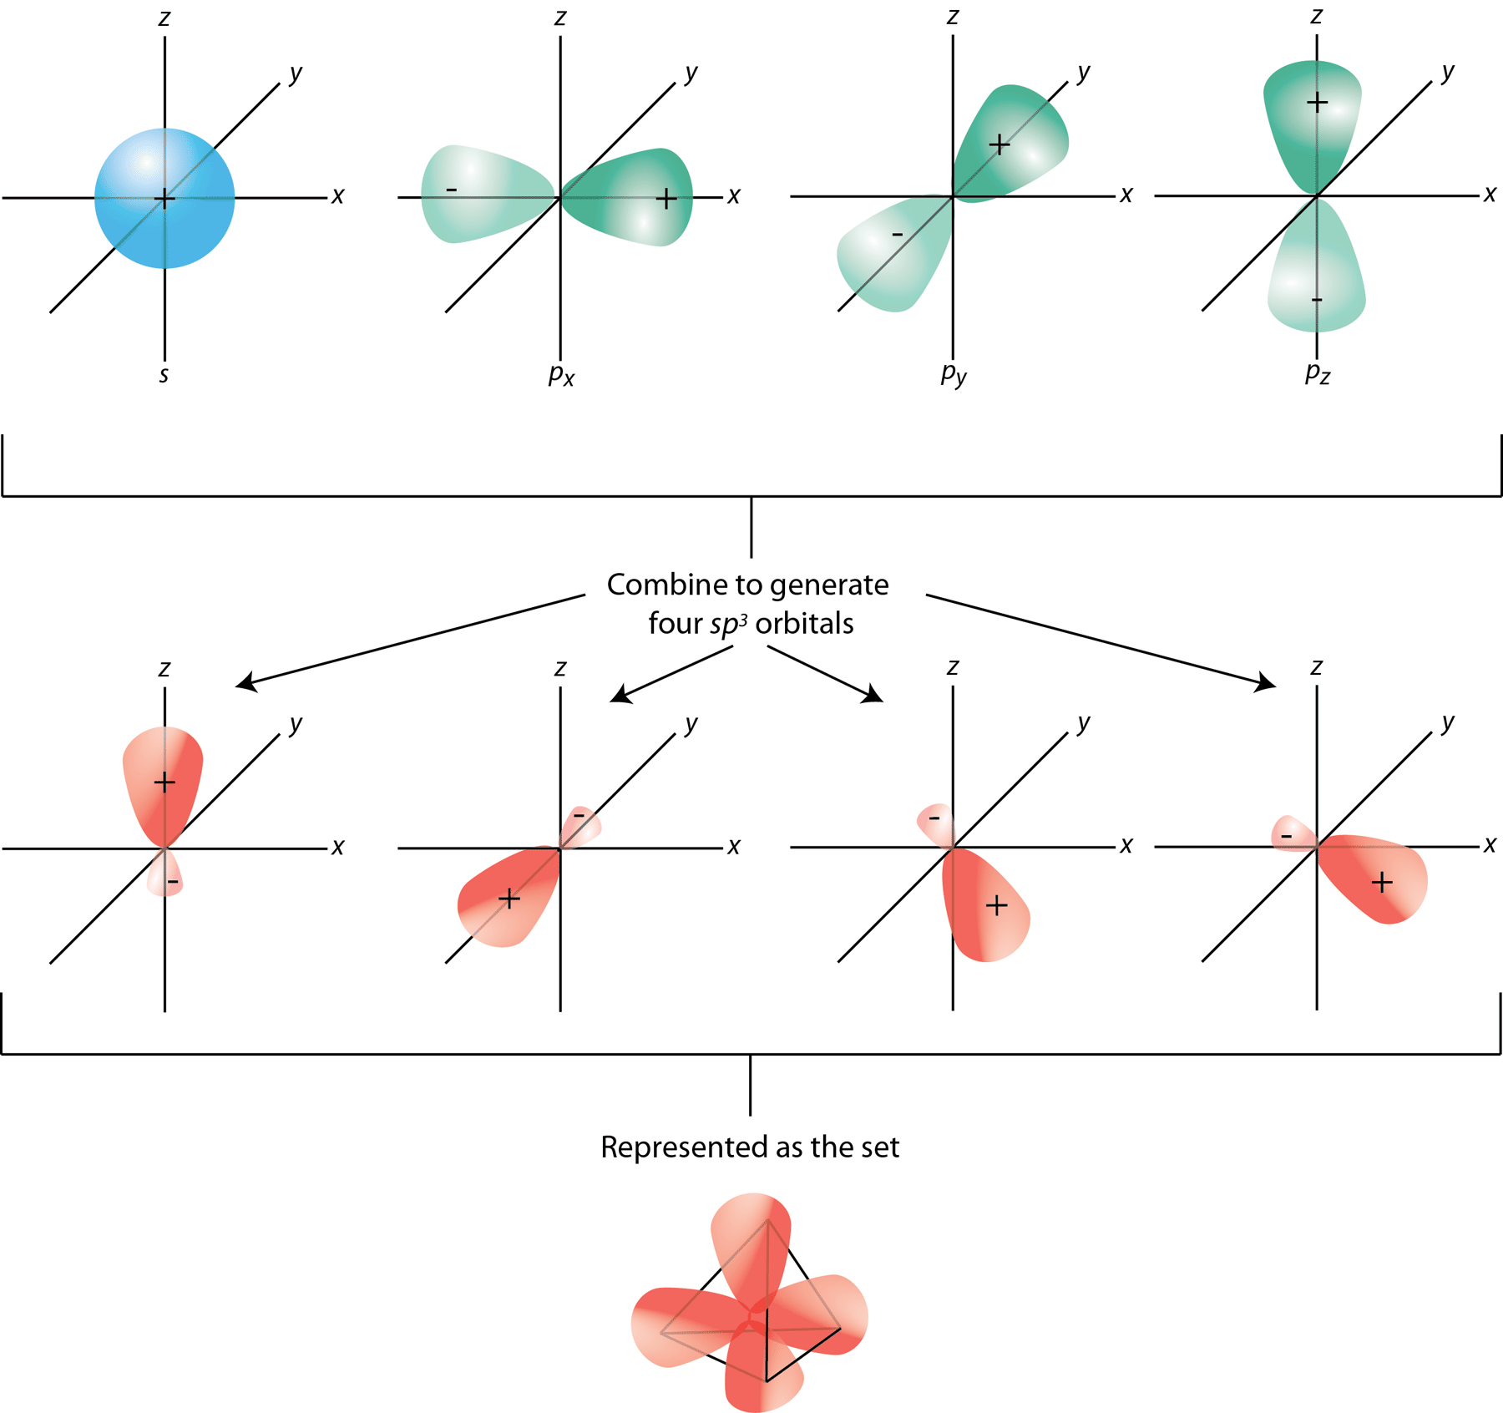
Orbitals
One way to fill carbon orbitals
hybridization orbitals

Slide 5
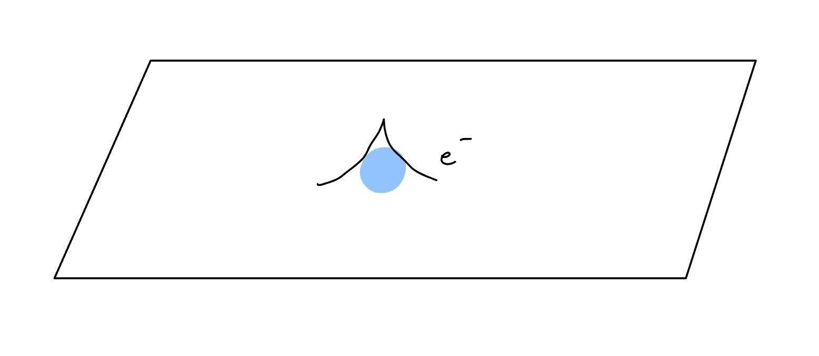
Diamond Lattice and Unit Cell
Defects in lattice → lowers symmetry
Wavefunction can be localized, both ground state and excited states situated inside the band gap (not guaranteed)

Slide 6
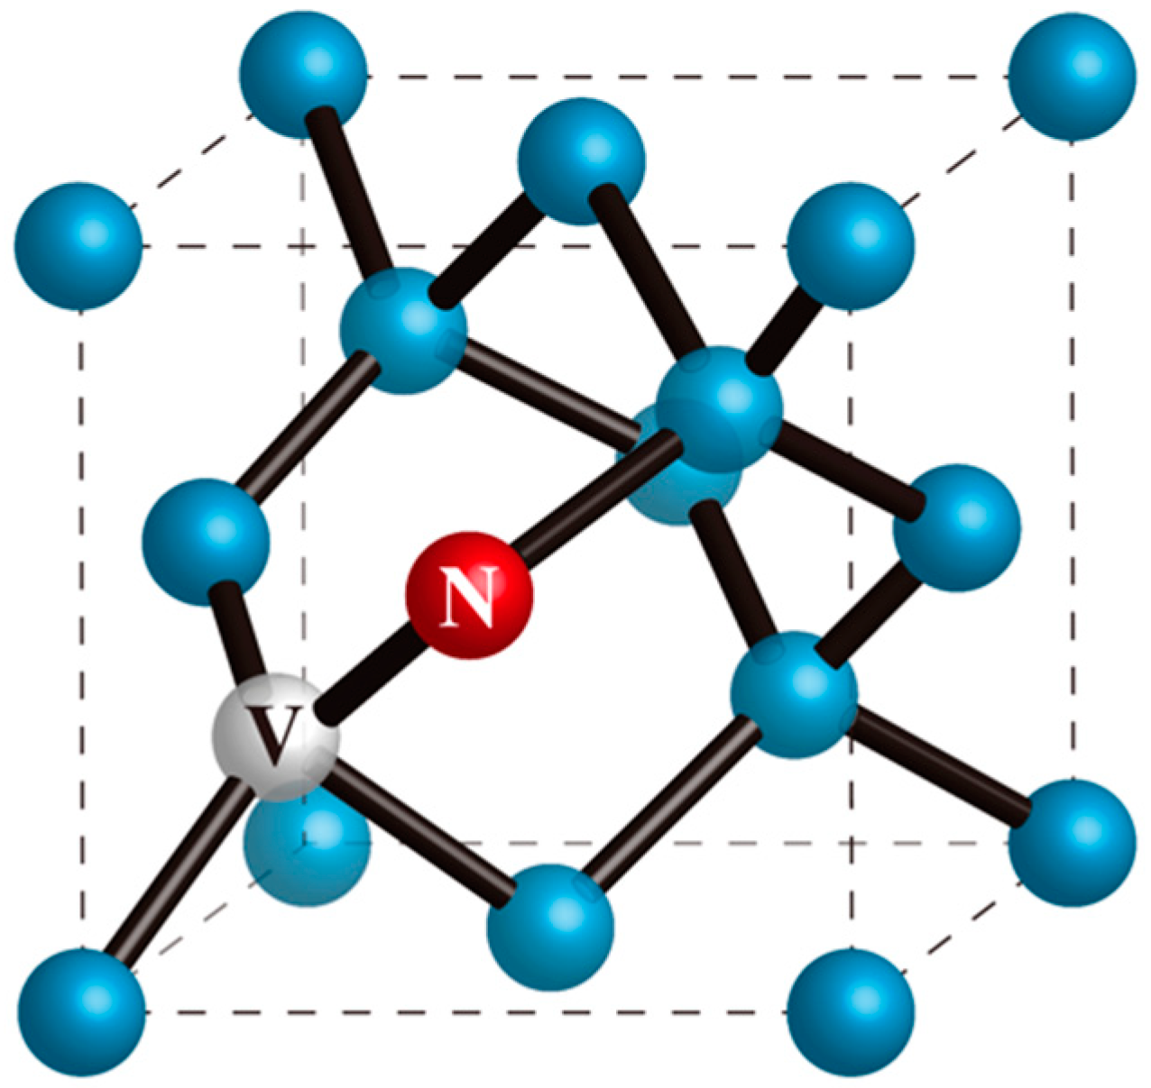
NV-Center
Replaced the center carbon with vacancy, and an adjacent carbon with nitrogen
The defect behaves like an “atom” even at room temperature → can
Polarize to a pure state
Perform measurement
Be coherently manipulated
Long coherence time (T1 ~ 10ms at 300K, ~1day at 100mK)
4 possible orientations

Slide 7
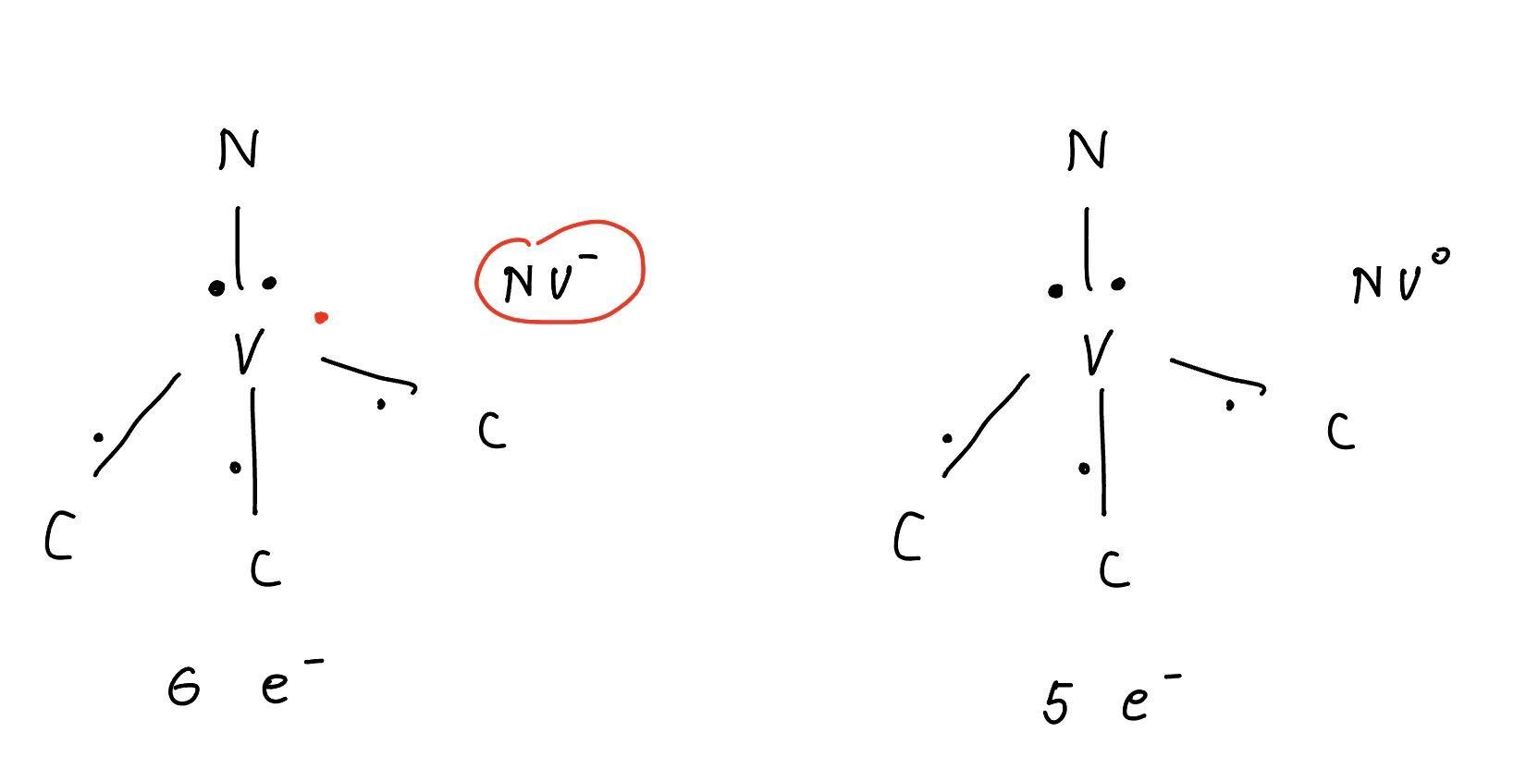
NV-Center
2 types of NV-Centers based on electron numbers
NV- is typically used and more common than NV0

Slide 8
Why Using NV-Center
Sensing (local addressing, high resolution → promising)
Computation (for computing and for memory, error correction) (sad)
Analog simulation (Hamiltonian engineering) (disordered interaction → interesting, but requires complex Hamiltonian engineering, big topic)
Network (Entanglement generation) (sad, no one does this in NV, NV’s don’t even resonantly couple)

Slide 9
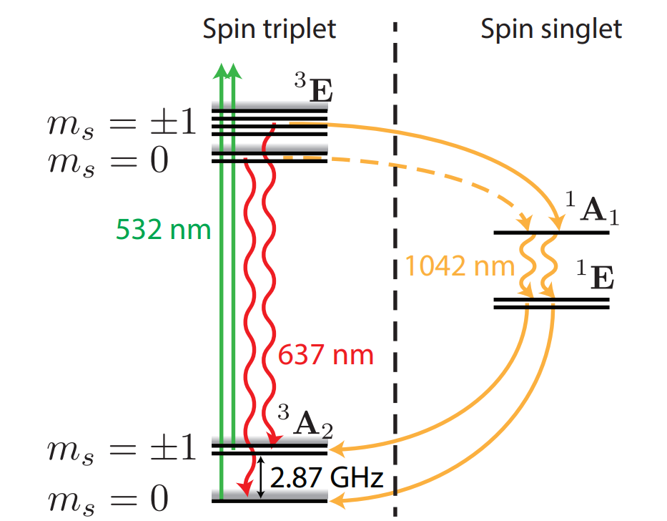
How to Get NV-Center’s Ground State Level Structure (handwavy)
Just do a DFT
Use some group theory → gives more intuition, does not always work
General idea:
Find all symmetries of the defect → form point group
Hamiltonian and eigenstates must obey these symmetries
Obtain irreducible representations of the point group → the irrep basis should be the eigenstates
Fill in electrons
Use physics intuition to construct the respect energy level of these eigenstates
NV-Center Ground State Levels
Satcher Hsieh Thesis

Slide 10
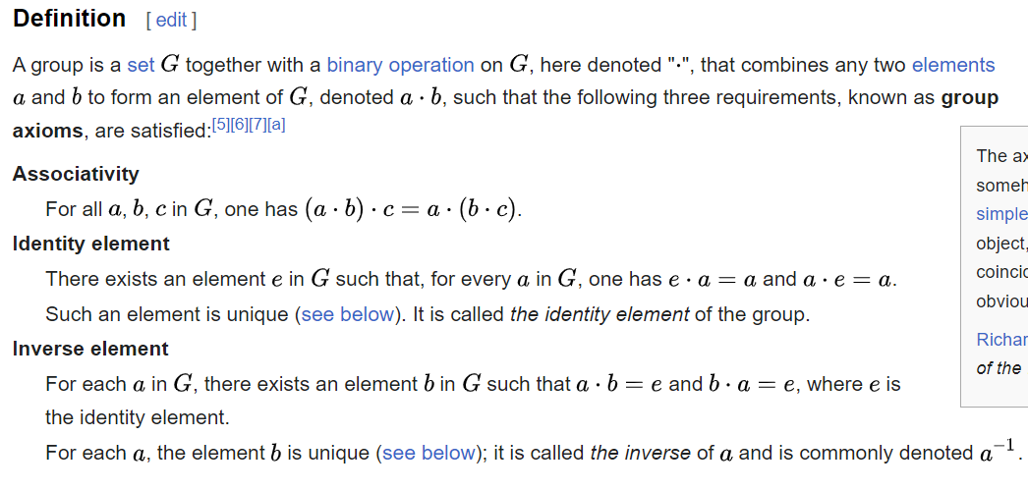
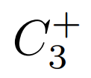
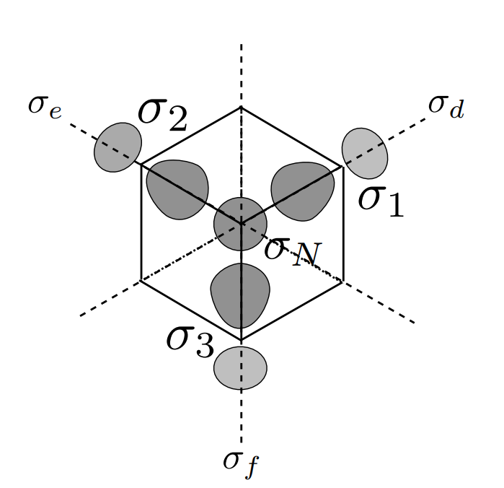
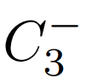
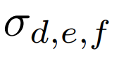
C3v Point Group
Rotation of 120deg CW
Rotation of 120deg CCW
3 reflection axis
Identity
Find a representation
Representation is a mapping from one group to another group that preserves the group algebraic structure
Top down view of NV-center
Operator to matrix mapping is a representation
Most of times people call the image the representation

Slide 11
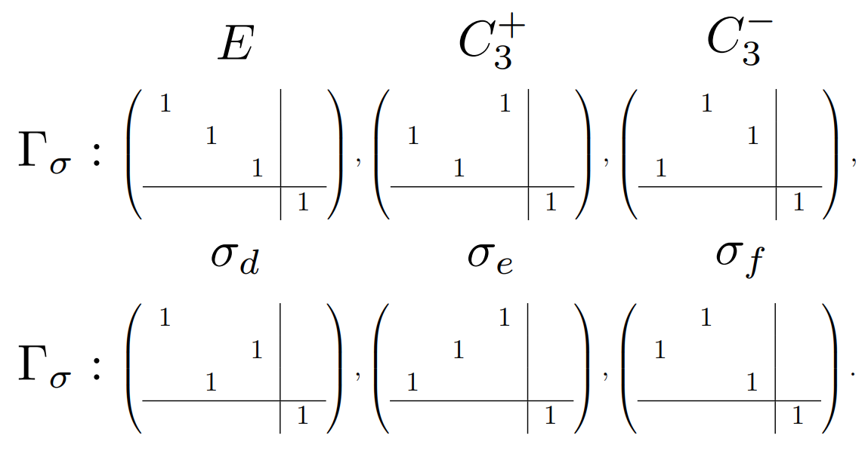
One Representation in the sp3 Orbital Basis
The three carbon orbitals are indistinguishable, but the nitrogen orbital is distinguishable
All these matrices are block diagonalized the same way

Slide 12

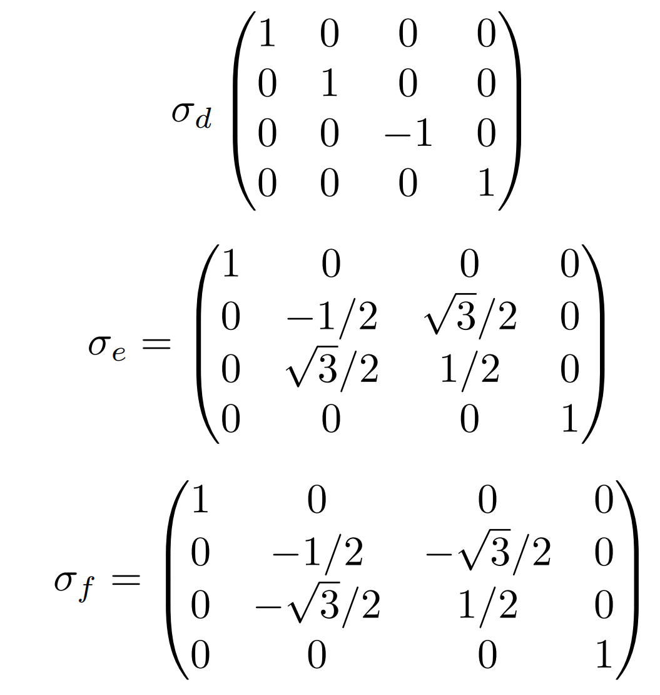
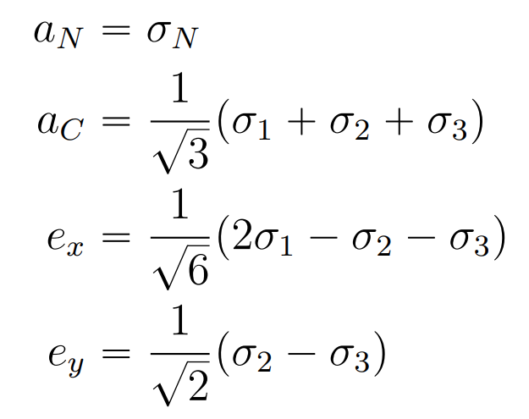
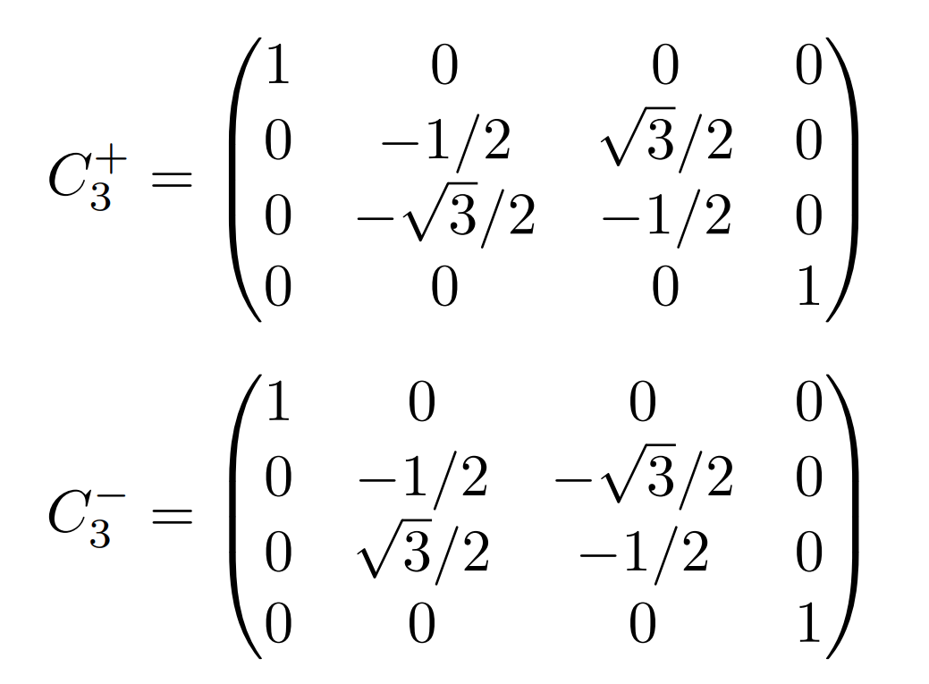
Obtaining Irrep (shoved under the rug)
Can we continue to block diagonalize the 3X3 matrices? Yes!
If we choose these basis:
Contains three blocks! Hamiltonian can also be block diagonalized the same way

Slide 13
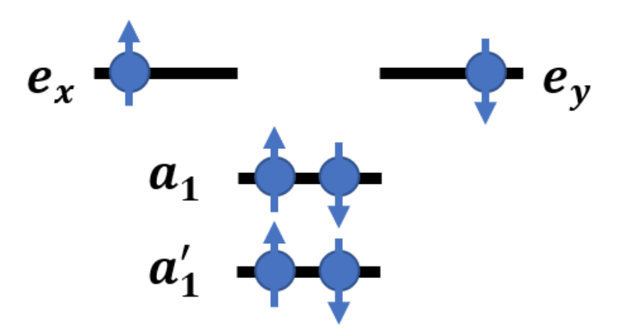
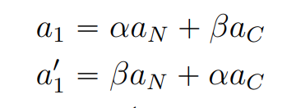
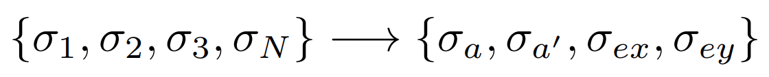
Continue
Adding in interaction between the electron and the nitrogen, the previous basis can no longer be irreps of C3v.
No need to worry. Basically did using irreps
eV scale in energy
Key takeaway:
NV-Center is like a 2 electron atom, an effective spin 1 particle!
Irrep 什么的好难！:(

Slide 14
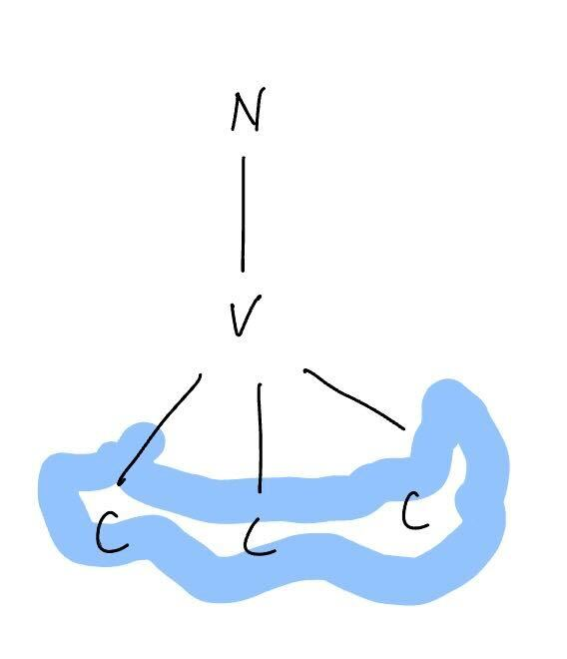
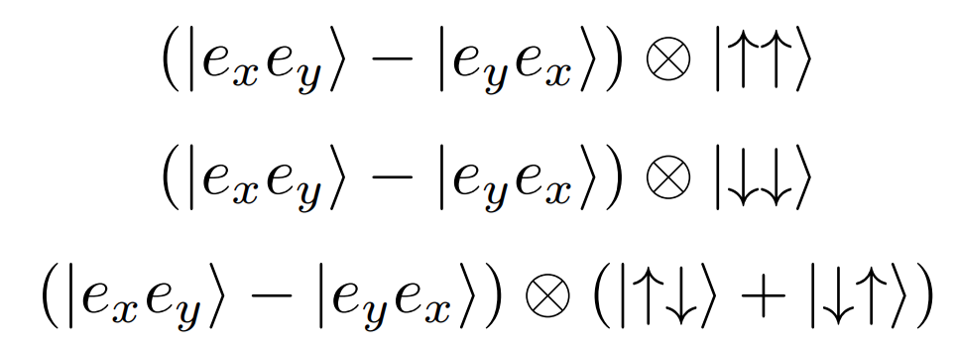
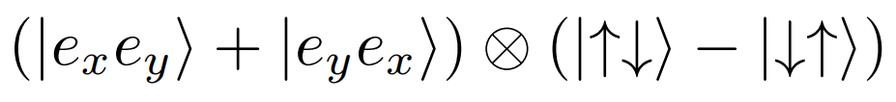
Fill in Electrons!
ex, ey orbitals are flat and localized around the carbons
State = orbital part tensor spin part
Triplet:
Singlet:
eV scale in energy
Which one has higher energy?
The singlet!

Slide 15
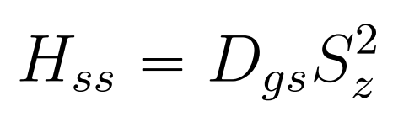
Ground State Level Structure
Higher energy
singlet
Through more group theory stuff, we can obtain a Hamiltonian from purely spin spin interaction
Dgs originates from electron electron Ising interaction, called Zero Field Splitting (ZFS)
ms= 1
ms= -1
ms= 0
triplet

Slide 16
Some Comments about ZFS
Electron d-d interaction at bond length ~ 2 angstrom, estimated Dgs ~ 3GHz
Measurement shows 2.87GHz == microwave range
ZFS decreases with increasing temperature at -75 kHz/K

Slide 17
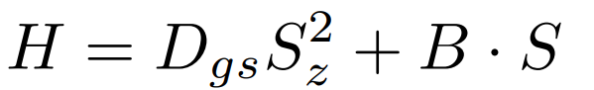
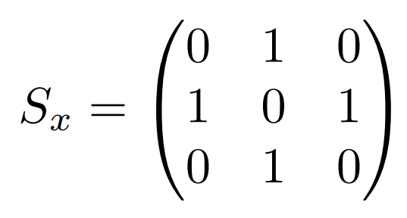
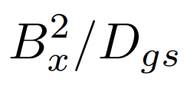
Coupling to External B field
Higher energy
singlet
Can be used to measure external B field
X field couples +1, -1 states at 2nd order
Interaction strength
ms= 1
ms= -1
Sx
Sx
Only non-zero at 2nd order perturbation
ms= 0
triplet

Slide 18
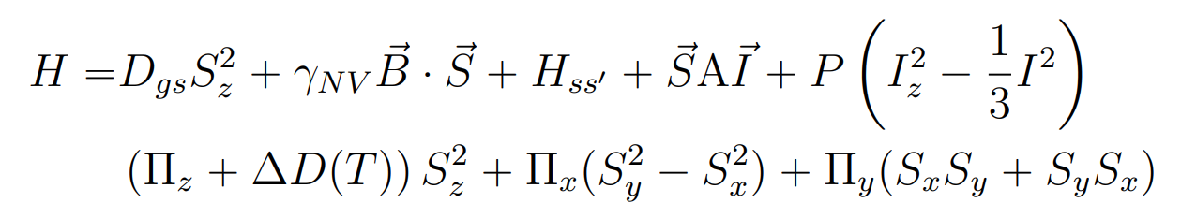
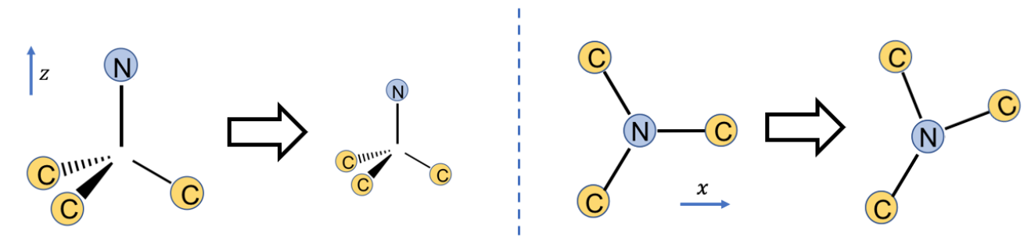
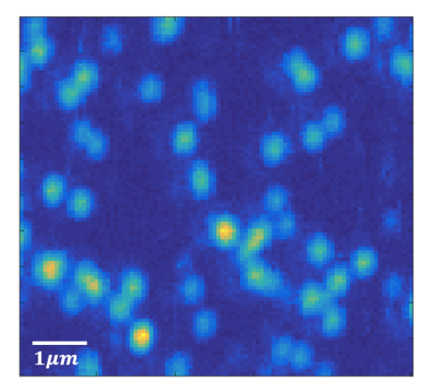

Additional Comments
Can couple to electric field
Weak susceptibility
Perpendicular E field is not suppressed
Can Couple to Strain
Other things to talk about:
How to initialize
How to read out
Miller Index → Diamond cuts
Different direction can detect different stuff
Environment
Isotopes of carbon, isotopes of nitrogen
P1 Centers
NV based relaxonomy (T1, T2*, T2)
Millikelvin experiment in dil-fridge
Real image of NV-Center (confocal scan)
Thomas Mittiga thesis

